Slide 1
Aggregation Framework

Slide 2
What is Aggregation in MongoDB?
Aggregation is a way of processing a large number of documents in a collection by means of passing them through different stages. The stages make up what is known as a pipeline. The stages in a pipeline can filter, sort, group, reshape and modify documents that pass through the pipeline.
One of the most common use cases of Aggregation is to calculate aggregate values for groups of documents. This is similar to the basic aggregation available in SQL with the GROUP BY clause and COUNT, SUM and AVG functions.
MongoDB Aggregation goes further though and can also perform relational-like joins, reshape documents, create new and update existing collections, and so on.

Slide 3
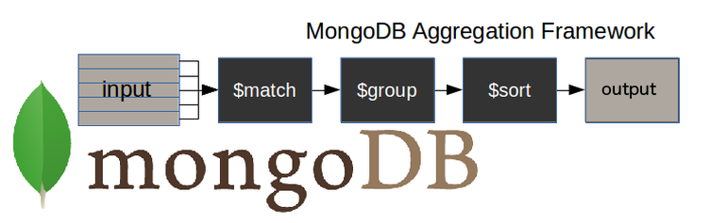
How does the MongoDB aggregation pipeline work?
$match stage – filters those documents we need to work with, those that fit our needs
$group stage – does the aggregation job
$sort stage – sorts the resulting documents the way we require (ascending or descending)
The input of the pipeline can be a single collection, where others can be merged later down the pipeline.
The pipeline then performs successive transformations on the data until our goal is achieved.
This way, we can break down a complex query into easier stages, in each of which we complete a different operation on the data. So, by the end of the query pipeline, we will have achieved all that we wanted.
This approach allows us to check whether our query is functioning properly at every stage by examining both its input and the output. The output of each stage will be the input of the next.
There is no limit to the number of stages used in the query, or how we combine them.

Slide 4
MongoDB aggregate pipeline syntax
This is an example of how to build an aggregation query:
db.collectionName.aggregate(pipeline, options),
where collectionName – is the name of a collection,
pipeline – is an array that contains the aggregation stages,
options – optional parameters for the aggregation

Slide 5
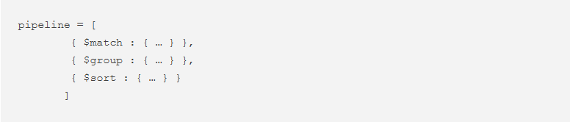
MongoDB aggregate pipeline syntax
This is an example of the aggregation pipeline syntax:

Slide 6
MongoDB aggregation stage limits
Aggregation works in memory. Each stage can use up to 100 MB of RAM. You will get an error from the database if you exceed this limit.
If it becomes an unavoidable problem you can opt to page to disk, with the only disadvantage that you will wait a little longer because it is slower to work on the disk rather than in memory.
To choose the page to disk method, you just need to set the option allowDiskUse to true like this:
db.collectionName.aggregate(pipeline, { allowDiskUse : true })

Slide 7
MongoDB aggregate examples
To illustrate the examples, we are going to use two collections. The first is called 'universities' and is made up of these documents:
Demo js file: universities.js, courses.js

Slide 8
MongoDB aggregate examples: Universities
Mongodb $match:
The $match stage allows us to choose just those documents from a collection that we want to work with. It does this by filtering out those that do not follow our requirements.
In the following example, we only want to work with those documents which specify that Spain is the value of the field country, and Salamanca is the value of the field city.
In order to get a readable output, I am going to add .pretty() at the end of all the commands.
db.universities.aggregate([
{ $match : { country : 'Spain', city : 'Salamanca' } }
]).pretty()
=> SELECT * FROM Universities WHERE country = 'Spain' AND city = 'Salamanca';

Slide 9
MongoDB aggregate examples: Universities
MongoDB $project:
t is rare that you ever need to retrieve all the fields in your documents.
It is good practice to return only those fields you need so as to avoid processing more data than is necessary.
The $project stage is used to do this and to add any calculated fields that you need.
In this example, we only need the fields country, city and name.
In the code that follows, please note that:
We must explicitly write _id : 0 when this field is not required
Apart from the _id field, it is sufficient to specify only those fields we need to obtain as a result of the query:
db.universities.aggregate([
{ $project : { _id : 0, country : 1, city : 1, name : 1 } }
]).pretty()
➔SELECT country, city, name FROM Universities;

Slide 10
MongoDB aggregate examples: Universities
MongoDB $group:
With the $group stage, we can perform all the aggregation or summary queries that we need, such as finding counts, totals, averages or maximums.
In this example, we want to know the number of documents per university in our ‘universities’ collection:
The query:
db.universities.aggregate([
{ $group : { _id : '$name', totaldocs : { $sum : 1 } } }
]).pretty()
➔ SELECT name, COUNT(*) AS totaldocs FROM Universities GROUP BY name;

Slide 11
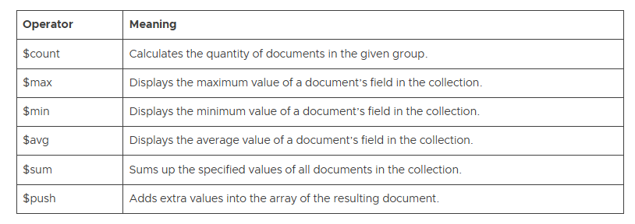
MongoDB $group aggregation operators
The $group stage supports certain expressions (operators) allowing users to perform arithmetic, array, boolean and other operations as part of the aggregation pipeline.

Slide 12
MongoDB $out
This is an unusual type of stage because it allows you to carry the results of your aggregation over into a new collection, or into an existing one after dropping it, or even adding them to the existing documents.
The $out stage must be the last stage in the pipeline.
For the first time, we are using an aggregation with more than one stage. We now have two, a $group and an $out:
db.universities.aggregate([
{ $group : { _id : '$name', totaldocs : { $sum : 1 } } },
{ $out : 'aggResults' }
])
This create a new collection: aggResults!
db.aggResults.find().pretty()

Slide 13
SQL equivalent:
-- Assuming a new table needs to be created
CREATE TABLE aggResults (
name VARCHAR(255),
totaldocs INT
);
-- Insert the aggregation results into the new table
INSERT INTO aggResults (name, totaldocs)
SELECT name, COUNT(*) AS totaldocs
FROM Universities GROUP BY name;

Slide 14
MongoDB $unwind
The $unwind stage in MongoDB's aggregation framework is used to deconstruct an array field from the input documents and then output one document for each element of the array. This operation is particularly useful when you want to flatten an array and perform operations on the individual elements as if they were part of separate documents.
Hence, where there is an array field within the input documents, you will sometimes need to output the document several times, once for every element of that array.

Slide 15
$unwind example:
db.universities.aggregate([
{ $match : { name : 'USAL' } },
{ $unwind : '$students' }
]).pretty()
-- Assuming there's a normalized structure where `Students` is a separate table
SELECT u.name, s.year, s.number
FROM Universities AS u
JOIN Students AS s ON u.id = s.university_id
WHERE u.name = 'USAL';

Slide 16
MongoDB $sort
You need the $sort stage to sort your results by the value of a specific field.
For example, let’s sort the documents obtained as a result of the $unwind stage by the number of students in descending order.
In order to get a lesser output, I am going to project only the year and the number of students:
db.universities.aggregate([
{ $match : { name : 'USAL' } },
{ $unwind : '$students' },
{ $project : { _id : 0, 'students.year' : 1, 'students.number' : 1 } },
{ $sort : { 'students.number' : -1 } }
]).pretty()

Slide 17
SELECT s.year, s.number
FROM Universities AS u
JOIN Students AS s ON u.id = s.university_id
WHERE u.name = 'USAL'
ORDER BY s.number DESC;

Slide 18
MongoDB $limit
What if you are only interested in the first two results of your query? It is as simple as:
db.universities.aggregate([
{ $match : { name : 'USAL' } },
{ $unwind : '$students' },
{ $project : { _id : 0, 'students.year' : 1, 'students.number' : 1 } },
{ $sort : { 'students.number' : -1 } },
{ $limit : 2 }
]).pretty()

Slide 19
SELECT s.year, s.number
FROM Universities AS u
JOIN Students AS s ON u.id = s.university_id
WHERE u.name = 'USAL'
ORDER BY s.number DESC
LIMIT 2;

Slide 20
Mongodb $addFields
It is possible that you need to make some changes to your output in the way of new fields. In this example, we want to add the year of the foundation of the university:
db.universities.aggregate([
{ $match : { name : 'USAL' } },
{ $addFields : { foundation_year : 1218 } }
]).pretty()
SELECT *, 1218 AS foundation_year FROM Universities WHERE name = 'USAL';

Slide 21
MongoDB $count
The $count stage provides an easy way to check the number of documents obtained in the output of the previous stages of the pipeline:
db.universities.aggregate([
{ $unwind : '$students' },
{ $count : 'total_documents' }
]).pretty()
SELECT COUNT(*) AS total_documents FROM Students WHERE UniversityID IN (SELECT UniversityID FROM Universities);

Slide 22
MongoDB $lookup
Using the $lookup, here is an aggregate query that merges fields from two collections:
db.universities.aggregate([
{ $match : { name : 'USAL' } },
{ $project : { _id : 0, name : 1 } },
{ $lookup : {
from : 'courses',
localField : 'name',
foreignField : 'university',
as : 'courses'
} }
]).pretty()
SELECT u.name, c.name AS course_name, c.levelFROM Universities uJOIN Courses c ON u.universityID = c.universityIDWHERE u.name = 'USAL';

